Slide 1

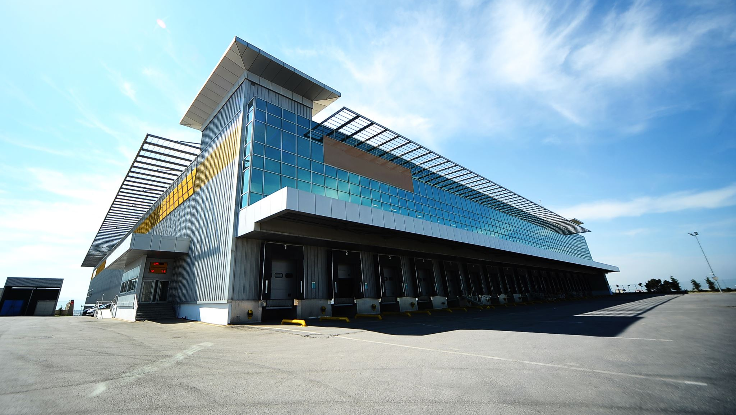
North Shore CPA Services
Financing Option
By Maksat Mametjumayev

Slide 2
Introduction
Loan Amount- $250,000
Option A
Term: 36 months
Interest rate: 4%
Option B
Term: 48 months
Interest rate: 4.5%
Option C
Term: 60 months
Interest rate: 5%

Slide 3
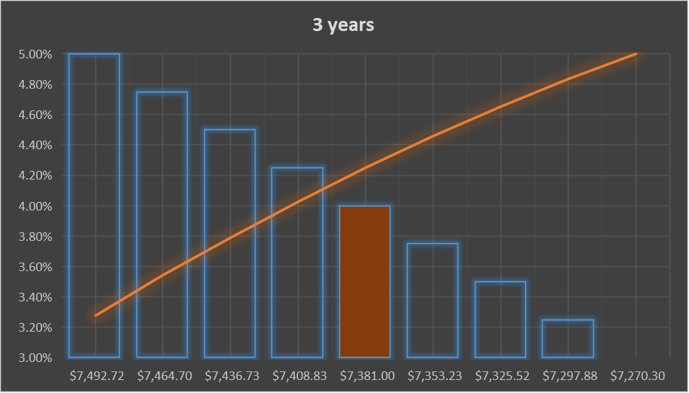
Option A: Term-36 months; Interest rate-4%

Slide 4
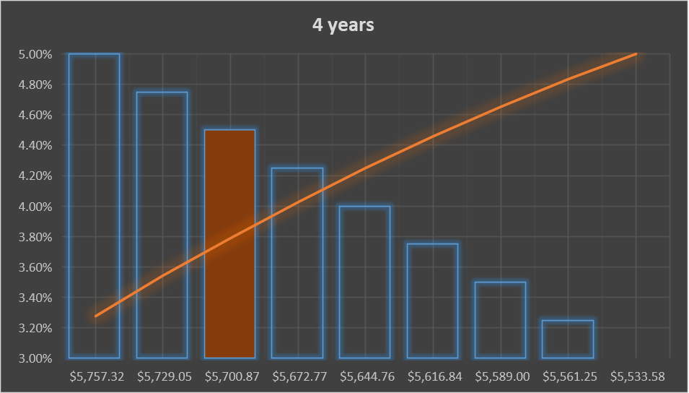
Option B: Term-48months; Interest rate-4.5%

Slide 5
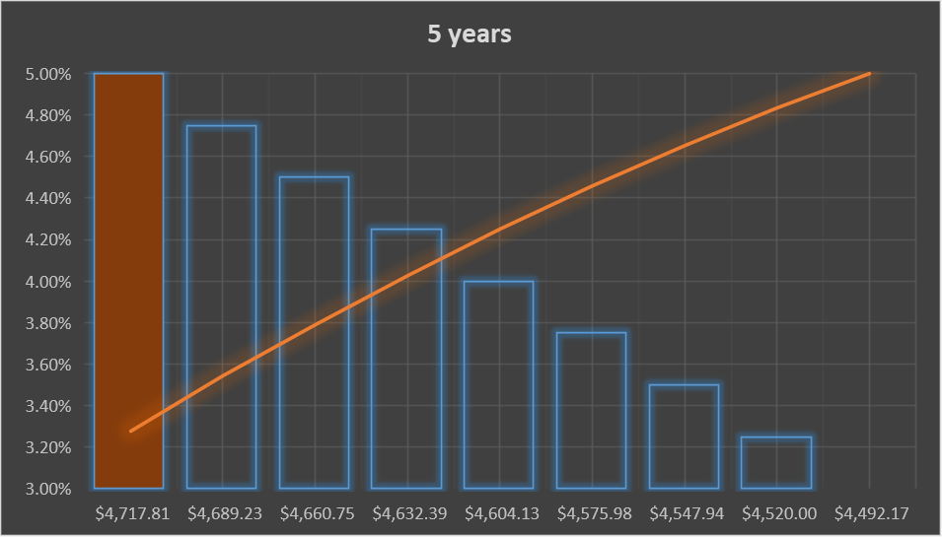
Option C: Term-60 months; Interest rate-5%

Slide 6
Scenario Summary

Slide 7
Recommendation
Option A is a better option among other alternatives because the total payment of the loan and total interest are the lowest amount among other alternatives. This will prevent the company from failing the loan payment and facing other future risks.

